Slide 1
Introduction to Internal Storage in Android

Slide 2
Agenda
Overview of Android Internal Storage Options
Introduction to SharedPreferences

Slide 3
1. Internal Storage
Internal Storage is private storage space within the app’s directory that only the app can access.
Files saved here are not accessible to other apps or users, providing a secure location for sensitive data. When the app is uninstalled, the data in Internal Storage is automatically deleted.
Key Characteristics:
Private to the App: Only the app that created the file can access it.
Automatic Cleanup: Files are deleted when the app is uninstalled.
No Permission Needed: Unlike external storage, you don’t need any special permissions to use internal storage.
Security: Suitable for storing sensitive data since it's only accessible by the app.
When to Use Internal Storage:
Sensitive Information: Storing personal data like login credentials or user data.
Small Files: Internal storage is best used for small files (documents, app settings, etc.).
Permanent Data: When the data needs to be stored for the app's lifetime, internal storage is suitable.

Slide 4
FileOutputStream fos = openFileOutput("filename.txt", Context.MODE_PRIVATE);
fos.write(data);
fos.close();

Slide 5
2. External Storage
External Storage refers to the shared storage on the device (like SD cards or other external storage spaces). Both apps and users can access files stored here, making it useful for data that should be accessible by other apps or media (like photos, videos, or downloads). However, files stored here may not be private, and there’s no guarantee they’ll be available if external storage is removed.
Key Characteristics:
Shared: Other apps and users can access files stored on external storage.
Requires Permission: Accessing external storage requires permissions (READ_EXTERNAL_STORAGE and WRITE_EXTERNAL_STORAGE).
Persistence: Data persists across app uninstalls, unless manually deleted by the user.
Vulnerable to Loss: If the external storage is removed or reformatted, the data can be lost.
Larger Space: Suitable for large files like media files, downloads, or backups.
When to Use External Storage:
Large Files: Multimedia files (images, videos, audio).
Shared Access: Files that need to be shared between apps or accessed by the user outside the app.
Backups: Data that should persist even if the app is uninstalled.

Slide 6
File file = new File(Environment.getExternalStoragePublicDirectory(Environment.DIRECTORY_PICTURES), "picture.jpg");

Slide 7
3. Cache Storage
Cache is temporary storage used by the app to store frequently accessed data or results that are computationally expensive to retrieve (e.g., downloaded images, search results, etc.). Cache files are not meant to be persistent. Android may delete cached data when the system runs low on space, and the app should be prepared for that.
Key Characteristics:
Temporary Storage: Data can be deleted at any time by the system when space is low.
Automatic Cleanup: Cached data may be cleared by the system without warning.
No Permission Required: Cache can be used without any specific permission.
Improves Performance: Caching can significantly reduce the time and resources needed to load data.
When to Use Cache:
Temporary Data: For data that can be easily regenerated or downloaded, such as image thumbnails, API responses, or search results.
Performance: When performance is critical and you want to avoid redundant network requests or expensive computations.

Slide 8
File cacheDir = getCacheDir();
File tempFile = File.createTempFile("prefix", "extension", cacheDir);

Slide 9
4. SharedPreferences
SharedPreferences is used to store small amounts of key-value pair data. This is ideal for storing simple data such as user preferences (e.g., theme, login status, app settings). It’s not suitable for complex or large data structures.
Key Characteristics:
Simple Key-Value Storage: Stores data in a key-value pair format (e.g., a string representing user preference).
Persistent: Data is stored across app restarts.
Private: Data is stored in the app's internal storage and can only be accessed by the app.
No Complex Data Structures: Best for storing primitive types such as String, Int, Boolean.
When to Use SharedPreferences:
User Settings: Saving preferences like theme, language, or login status.
Simple Data: Data that is easily represented as key-value pairs and doesn't require a complex data structure.

Slide 10
SharedPreferences sharedPref = getSharedPreferences("MyPrefs", Context.MODE_PRIVATE);
SharedPreferences.Editor editor = sharedPref.edit();
editor.putString("username", "JohnDoe");
editor.apply();

Slide 11
5. SQLite Database
SQLite is a lightweight relational database embedded within Android. It is designed to store structured, relational data in a secure and consistent manner. It’s suitable for apps that need to manage complex data and perform CRUD operations (Create, Read, Update, Delete).
Key Characteristics:
Structured Data: Suitable for storing structured data like records, relationships, etc.
Relational Database: Uses SQL queries to manipulate data.
Persistent: Data is stored across app restarts.
Private to the App: Stored in the app’s internal storage, and only accessible to the app.
When to Use SQLite:
Complex Data: When you need to manage multiple types of structured data, such as user profiles, products, etc.
Relational Data: When relationships between data (e.g., foreign keys) are important.

Slide 12
6. ContentProviders
ContentProviders are used to share data between different apps. They provide an interface for sharing structured data that can be accessed by other applications, often through a URI. Common examples include the Contacts and Media databases.
Key Characteristics:
Data Sharing Between Apps: Allows other apps to query or manipulate your app’s data.
Standardized Access: Exposes data through a URI, and other apps can access it using ContentResolvers.
Permission-based Access: You can define permissions for accessing your data.
When to Use ContentProviders:
Data Sharing: When your app needs to expose its data to other apps (e.g., Contacts, Media).
Complex Queries: When structured data needs to be accessed across apps with control over read/write permissions.

Slide 13
Cursor cursor = getContentResolver().query(uri, projection, selection, selectionArgs, sortOrder);

Slide 14
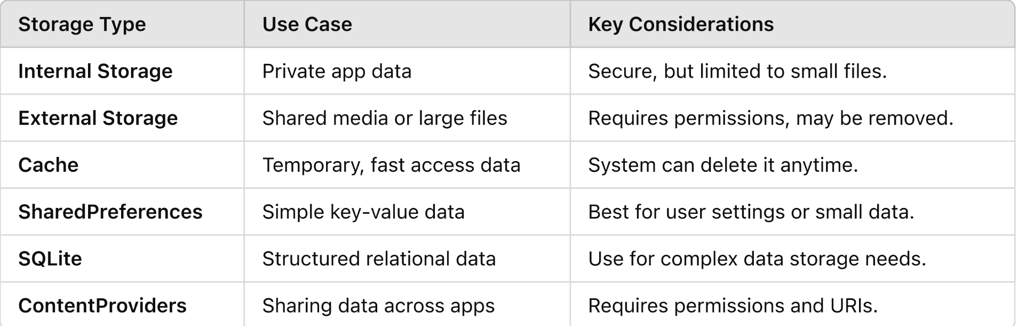
Choosing the Right Storage Mechanism

Slide 15
What is SharedPreferences?
SharedPreferences is a simple way to store small amounts of data as key-value pairs in Android.
It’s part of the Android framework and allows for persistent storage, which means the data is retained even after the app is closed or the device is restarted.
SharedPreferences is stored in XML format within the app's internal storage, making it both lightweight and secure, as other apps cannot access its data

Slide 16
Simple Key-Value Storage in Android
In SharedPreferences, data is stored in the form of key-value pairs. The "key" is a string that acts as a unique identifier for the value, and the "value" can be one of the following primitive data types:
String
int
float
long
boolean
Key Features of SharedPreferences:
Persistent Data: Data remains across app sessions and is removed only when the user clears app data or when the app explicitly deletes it.
Simple Storage: It’s best used for small, simple data storage needs.
Secure: Data is private to the app, stored in internal storage.

Slide 17
When to Use SharedPreferences
SharedPreferences is best used for storing simple data that doesn’t require complex structures like tables or relational data. Some typical use cases include:
User Preferences:
Example: Theme settings (dark/light mode), language settings, notifications preferences, etc.
Login Status:
Example: Saving whether a user is logged in or not, which can be checked when the app starts.
App Configuration Data:
Example: Storing user-specific app configuration settings, such as volume levels or screen brightness.
Session Data:
Example: Temporary data like the last page viewed or last item clicked can be saved using SharedPreferences.
SharedPreferences is not suitable for storing large amounts of data or data with complex relationships (like a list of objects). For more complex storage needs, SQLite databases or other mechanisms like external storage or cloud-based storage would be more appropriate.

Slide 18
Code Example: Creating, Writing to, and Reading from SharedPreferences
Let’s walk through a basic example of using SharedPreferences to store and retrieve user preferences in an Android app.
Creating a SharedPreferences Instance You can get the SharedPreferences instance by calling getSharedPreferences() or getPreferences() (in an activity), which returns the SharedPreferences object.
Writing Data to SharedPreferences Writing data involves using the SharedPreferences.Editor class, which allows you to put data into the preferences and then commit or apply the changes.
Reading Data from SharedPreferences To retrieve data, you use the getString(), getInt(), getBoolean(), etc., methods depending on the type of data you stored.

Slide 19
Using SharedPreferences in Detail
SharedPreferences is a simple and effective way to store small amounts of data in Android applications. It’s commonly used to store user preferences, app settings, and other small pieces of data that need to persist across sessions. In this detailed explanation, we will cover the following aspects of SharedPreferences:
Saving Data in SharedPreferences
Commit vs Apply: Synchronous vs Asynchronous Data Saving
Retrieving Data from SharedPreferences
Removing or Clearing Data from SharedPreferences

Slide 20
1. Saving Data in SharedPreferences
To save data into SharedPreferences, you first need to create or access an existing SharedPreferences object. After that, you can use the SharedPreferences.Editor interface to modify the stored data by adding or updating values in the form of key-value pairs.
Steps for Saving Data:
Step 1: Access the SharedPreferences instance.
Step 2: Obtain the SharedPreferences.Editor object by calling edit().
Step 3: Use putX methods (putString, putInt, putBoolean, etc.) to add data.
Step 4: Save the changes using either apply() (asynchronous) or commit() (synchronous).
Here’s an example of saving user data (username, age, and login status):

